Slide 1
Asynchrony
EPFL Software Engineering

Slide 2
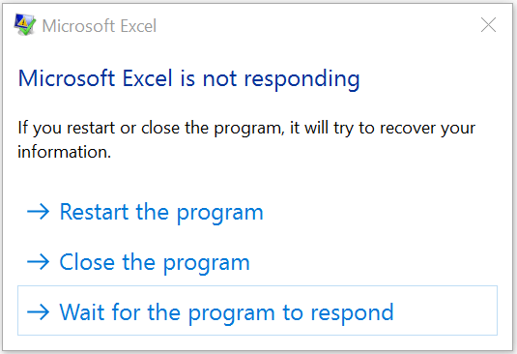
Sync
data = download();
process(data);

Slide 3
firstResult = computeFirst();
secondResult = computeSecond();
compare(firstResult, secondResult);
CPU 1
CPU 1
CPU 1
CPU 0
CPU 0
CPU 0

Slide 4
for (int i = 0; i < 100; i++) {
chunk = readFromDisk();
process(chunk);
}
CPU
CPU
Disk
Disk

Slide 5
Async
Start download
Progress bar
End download
Process

Slide 6
Compute 1
Compare
Compute 2

Slide 7
Read
Read
…
Process
Process
…

Slide 8
Objectives
Understand asynchrony in practice
Build async code with futures
Write tests for async code
Design async software components

Slide 9
What are async operations?

Slide 10
Async
“Start now, let me know when it’s done”
Concurrent, may or may not be parallel

Slide 11
Low-level computation
Threads
Processes
Fibers
…

Slide 12
Low-level interactions
Shared memory
Locks
Mutexes
Fork & join
…

Slide 13
But…
Low-level concurrency is very hard
Even for experts!

Slide 14
High-level goal
“Do stuff concurrently”

Slide 15
Async results
Start
Started
Done

Slide 16
Async errors
Start
Could not start
Could not finish

Slide 17
Async goals
Composable
Completion-based
Minimize shared state

Slide 18
Composition
“When the melted butter is cold AND the yeast has proofed, THEN mix them to form the dough”

Slide 19
“When the dough has risen AND the filling is cold, THEN fill the dough”

Slide 20
“Bake for 30 minutes OR until golden brown”

Slide 21



Error composition

Slide 22



Completion-based
Let me know when it’s baked

Slide 23
Readiness-based
Let me know when the
oven is free

Slide 24
Readiness problem
Client 1
Server
Client 2
Let me know
Ready
Do it
Do it

Slide 25
Shared state
Task 1
Task 2

Slide 26
Who goes first?
1
1
2
1
2
2

Slide 28


Message passing

Slide 29
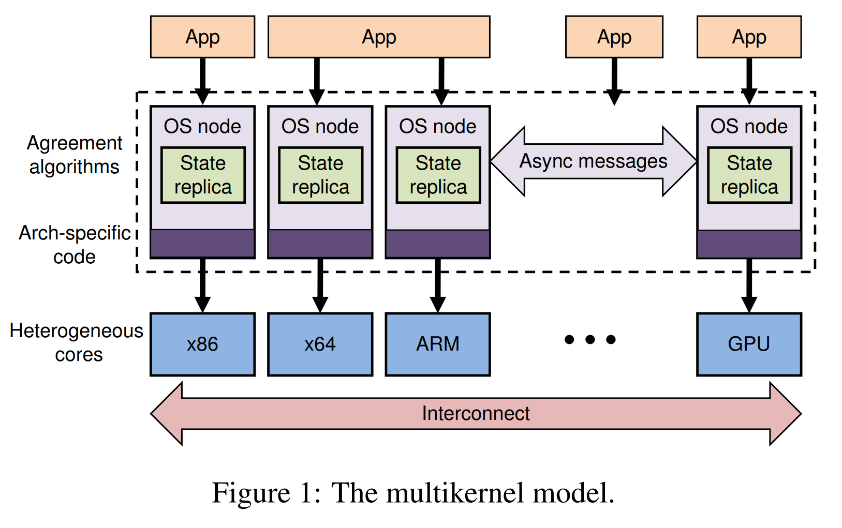
Baumann et al., The Multikernel: A new OS architecture for scalable multicore systems, SOSP ’09

Slide 30
How can we write maintainable async code?

Slide 31
Naïve version: Callbacks
void send(String text, Consumer<String> callback);
send("hello", reply -> {
System.out.println(reply);
});

Slide 32
Combining callbacks
send("hello", reply -> {
send("login", reply2 -> {
// ...
});
});

Slide 33
Error callbacks
void send(
String text,
Consumer<String> callback,
Consumer<Exception> errorCallback
);

Slide 34

“Callback hell”
send("hello", reply -> {
send("login", reply2 -> {
send("join", reply3 -> {
send("msg", reply4 -> {
send("msg", reply5 -> {
send("logout", reply6 -> {
// ...
}); }); }); }); }); });

Slide 35
Callbacks
Too low-level!

Slide 36
“Futures”
High-level object
Represents one of: In progress Result Error

Slide 37
Boxes
Future
if (x == 0) ... for (int n = 0; n < x; n++) { ... } return ...;

Slide 38
Future composition
“Done” AND “Error” = “Error”
“Done” THEN “In progress” = “In progress”
etc.

Slide 39
In Java
CompletableFuture<T>
“no result” = Void

Slide 40
Sync vs async
String getName();
void clear();
CompletableFuture<String> getNameAsync();
CompletableFuture<Void> clearAsync();

Slide 41
“Then”
CompletableFuture<String> future = ...
return future.thenAccept(System.out::println);
Async
Sync

Slide 42
return future.exceptionally(e -> e.getMessage())
.thenAccept(System.out::println);

Slide 43
return future.orTimeout(5, TimeUnit.SECONDS)
.exceptionally(e -> e.getMessage())
.thenAccept(System.out::println);

Slide 44
CompletableFuture<String> getMessage(); CompletableFuture<Void> log(String text);
return getMessage()
.thenCompose(log);
Async
Async

Slide 45
“And”
Async
Sync
CompletableFuture<String> getGreeting(); CompletableFuture<String> getName();
return getGreeting()
.thenCombine(getName(),
(g,n) -> g + n);
Async

Slide 46
“All”
Async
Async
CompletableFuture<Void>[] uploads = ...
for (int n = 0; n < uploads.length; n++) {
uploads[n] = ...
}
return CompletableFuture.allOf(uploads);
…

Slide 47
“Any”
CompletableFuture<Void>[] uploads = ...
for (int n = 0; n < uploads.length; n++) {
uploads[n] = ...
}
return CompletableFuture.anyOf(uploads);

Slide 48
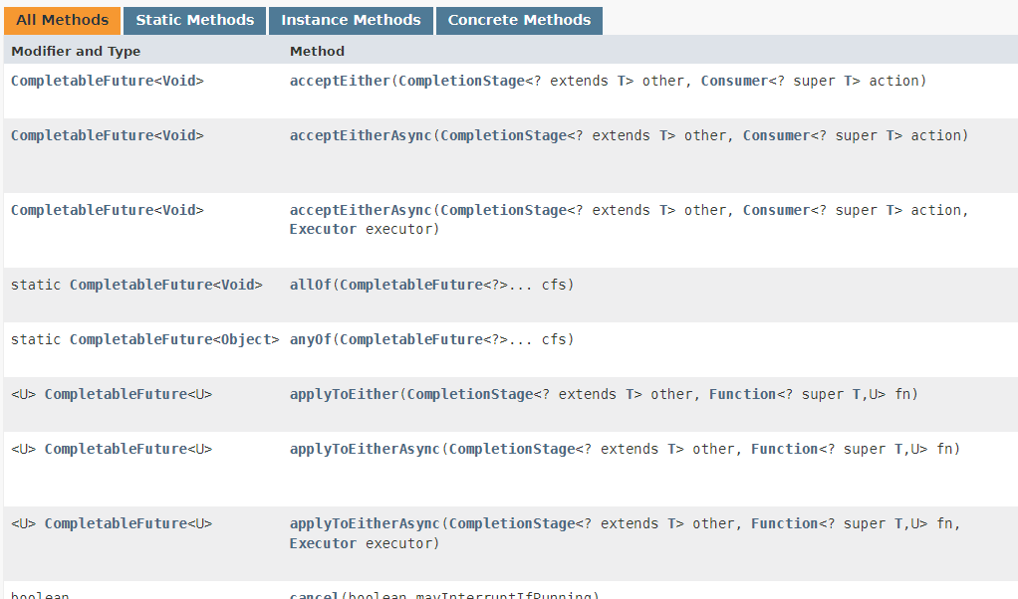
And so on…
https://docs.oracle.com/en/java/javase/17/docs/api/java.base/java/util/concurrent/CompletableFuture.html

Slide 49
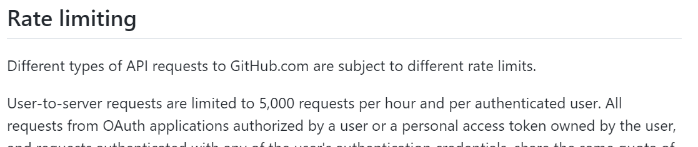
Warning: Rate limits
https://docs.github.com/en/rest/overview/resources-in-the-rest-api

Slide 50
Creation
var f = new CompletableFuture<String>();
new Thread(() -> {
// ...
f.complete("hello");
}).start();
return f;

Slide 51
new Thread(() -> {
// ...
f.completeExceptionally(...);
}).start();

Slide 52
return CompletableFuture.supplyAsync(() -> {
// ...
return "hello";
});

Slide 53
return CompletableFuture.completedFuture(
"hello"
);

Slide 54
Future creation is low-level
Implement infrastructure modules
“Convert” old async code
Rare

Slide 55
Exercise
Three tasks in Basics.java
Run App.java to check your results
First step: printTodaysWeather
Notes:
3min til next

Slide 56
return Weather.today()
.thenAccept(System.out::println);
Next step: uploadTodaysWeather
Notes:
2min til next

Slide 57
return Weather.today()
.thenCompose(Server::upload);
Next step: printSomeWeather
Notes:
3min til next

Slide 58
return Weather.today() .thenApply(w -> "Today: " + w) .acceptEither( Weather.yesterday() .thenApply(w->"Yesterday: " + w), System.out::println );

Slide 59
“Sync over async”
.join()
.isDone()
.isCompletedExceptionally()
...

Slide 60
“Sync over async” is for…
Java main() and JUnit @Tests
Infrastructure code
Not everyday async functions

Slide 61
Sync errors
Start
Could not start
Could not finish

Slide 62
Sync vs async errors in Java
throw new ...
→ try { ... } catch { ... }
return CompletableFuture.failedFuture(...)
→ future.exceptionally(...)

Slide 63
Sync errors are for…
Bugs!
e.g., IllegalArgumentException

Slide 64
Sync error example
CompletableFuture<Void> send(String s) {
if (s == null) {
throw new IllegalArgumentException(...);
}
... }

Slide 65
Never do this in Java
CompletableFuture<Void> send(String s) {
if (internetUnavailable) {
throw new IOError(...);
}
... }

Slide 66
Instead…
CompletableFuture<Void> send(String s) {
if (internetUnavailable) {
return CompletableFuture.failedFuture(...);
}
... }

Slide 67
Also never do this
CompletableFuture<Void> send(String s) {
if (s.equals("")) {
// Nothing to do
return null;
}
... }

Slide 68
Instead…
CompletableFuture<Void> send(String s) {
if (s.equals("")) {
return CompletableFuture .completedFuture(null);
}
... }

Slide 69
Canceling?
Start
Started
Done

Slide 70
Cancellation goal
“Stop”, not “ignore”

Slide 71
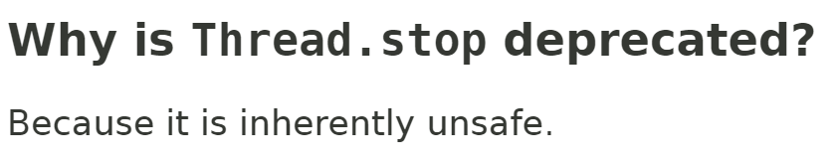
https://docs.oracle.com/en/java/javase/17/docs/api/java.base/java/lang/doc-files/threadPrimitiveDeprecation.html

Slide 72
Cooperative cancellation in Java
“Do it yourself”
e.g., with an AtomicBoolean “cancellation flag”

Slide 73
Coop. cancellation example
for (int step = 0; step < 100; step++) {
if (cancelFlag.get()) {
throw new CancellationException();
}
...
}

Slide 74

Should I?
Cancel

Slide 75
Progress
“23% done…”

Slide 76
Progress units
Files copied
Bytes downloaded
Emails sent
…

Slide 77
Progress in Java
“Do it yourself”
e.g., with an AtomicInteger counter

Slide 78
Progress example
for (int step = 0; step < 100; step++) {
progress.set(step);
...
}
progress.set(100);

Slide 79
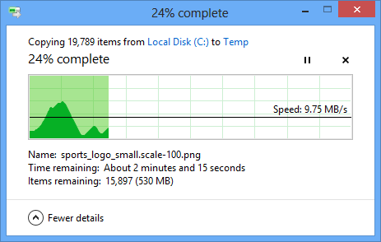
Hard to estimate time

Slide 80
Indeterminate progress

Slide 81
Exercise
Three tasks in Advanced.java
First step: upload
Notes:
4min til next

Slide 82
for (String text : texts) {
if (cancelFlag.get()) {
throw new CancellationException();
}
...
}

Slide 83
var cancelFlag = new AtomicBoolean(false);
return Server.uploadBatch(texts, cancelFlag) .orTimeout(2, TimeUnit.SECONDS) .exceptionally(e -> { cancelFlag.set(true); return null; }); Next step: download
Notes:
4min til next

Slide 84
var future = new CompletableFuture<String>();
OldServer.download( future::complete, future::completeExceptionally); return future.thenAccept(System.out::println);
Final step: reliableDownload
Notes:
3min til next

Slide 85
return download() .exceptionallyCompose( e -> reliableDownload() );

Slide 86
Futures in other languages
Promise (JavaScript)
Task<T> (C#)
Future (Rust)
...
Read the docs!

Slide 87
Async & await
Task<string> GetAsync(string url);
async Task WriteAsync() {
var text = await GetAsync("epfl.ch");
Console.WriteLine(text); }
(C#)

Slide 88
try
{
var text = await GetAsync("epfl.ch");
Console.WriteLine(text);
}
catch { ... }

Slide 89
Coroutines
suspend fun getAsync(url: String): String
suspend fun writeAsync() {
val content = getAsync("epfl.ch")
println(content)
}
(Kotlin)

Slide 90
try {
val text = getAsync("epfl.ch")
println(text)
} catch (e: Exception) { ... }

Slide 91
Futures as functions
Value | Error -> Future
Future + Function -> Future

Slide 92
Creation and composition
completedFuture: T -> CF<T> failedFuture: Throwable -> CF<T>
thenCompose: CF<T> + (T -> CF<U>) -> CF<U>

Slide 93
Optional<T>
of: T -> Opt<T> empty: () -> Opt<T>
flatMap: Opt<T> + (T -> Opt<U>) -> Opt<U>

Slide 94
General case
Create Value<T> from T
Map Value<T> with T -> Value<U> to Value<U>

Slide 95
Math names
“Create” = Return
“Map” = Bind
“Value” = Monad

Slide 96
Monads
“Design pattern” for abstractions

Slide 97
Monad example
return Weather.today()
.thenApply(w -> "Today: " + w)
.acceptEither(
Weather.yesterday() .thenApply(w->"Yesterday: " + w),
System.out::println );

Slide 98
How should we test async code?

Slide 99
Problem
void printWeather() {
getString(...)
.thenApply(parseWeather)
.thenAccept(System.out::println);
}

Slide 100
getString
thenAccept
Test

Slide 101
Test?
printWeather();
sleep(2_000);
// test output

Slide 102
Sleeping in tests
Slow
Brittle
Unreliable

Slide 103
Problem
void printWeather()
Tests cannot access the Future

Slide 104
Refactoring
CompletableFuture<Void> printWeather() {
return getString(...)
.thenApply(parseWeather)
.thenAccept(System.out::println);
}

Slide 105
Test?
printWeather().thenApply(r -> {
// ... test? ...
});

Slide 106
In Java & JUnit…
printWeather().join();
// ... test ...

Slide 107
printWeather()
.orTimeout(5, TimeUnit.SECONDS)
.join();
// ... test ...

Slide 108
…without extra dependencies
String weather = getWeather()
.orTimeout(5, TimeUnit.SECONDS)
.join();
// ... test weather ...

Slide 109
Not always feasible
@Override
void onClick(View v) { ... }

Slide 110
Add explicit callback
@Override
void onClick(View v) {
...
callback.run(); }
public void setCallback(...) { ... }

Slide 111
Testing callbacks?
setCallback(() -> {
// ... test? ...
});
// ... click the button ...

Slide 112
CountDownLatch latch = ...
// ... custom wait + timeout logic ...

Slide 113
Use Futures
var future = new CompletableFuture<Void>();
setCallback(() -> future.complete(null));
// ... click the button ...
future.orTimeout(5, TimeUnit.SECONDS) .join();

Slide 114
Exercise
Three tests in WeatherTests.java
First step: todaysWeatherIsSunny
Notes:
3min til next

Slide 115
String result = Weather.today() .orTimeout(5, TimeUnit.SECONDS) .join();
assertThat(result, is("Sunny"));
Next step: clickingButtonSetsWeatherToSunny
Notes:
3min til next

Slide 116
var future = new CompletableFuture<Void>();
WeatherView.setCallback( () -> future.complete(null) );
WeatherView.clickButton();

Slide 117
future.orTimeout(5, TimeUnit.SECONDS) .join();
assertThat( WeatherView.weather(), is("Sunny"));
Next step: weathersContainsYesterdayAndToday
Notes:
4min til next

Slide 118
printWeather:
return CompletableFuture.allOf(...)
Replace println with a Consumer<String>

Slide 119
var weathers = new ArrayList<String>();
Weather.printWeathers(weathers::add) .orTimeout(5, TimeUnit.SECONDS) .join();
assertThat( weathers, containsInAnyOrder(...));

Slide 120
How does asynchrony interact with software design?

Slide 121
Design question
What should be async?
Why?

Slide 122

Make everything async?
addAsync(1, 1) == Future(2)

Slide 123
Async is viral
async
sync
async
async
sync
async

Slide 124
...almost
join(), get(), ...
But hard to test, can deadlock
sync
async

Slide 125
Async is viral
async
async
interface
sync
sync

Slide 126



Example

Slide 127
Async interfaces
Operations expected to be async
Typically I/O

Slide 128
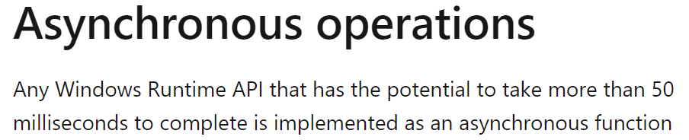
https://learn.microsoft.com/en-us/windows/uwp/cpp-and-winrt-apis/concurrency

Slide 129
“Could” take a while?
addAsync(1, 1)

Slide 130
“You Aren’t Gonna Need It”
Avoid unnecessary async
How painful would a change be?

Slide 131
Be consistent
class File {
CompletableFuture<String> read();
CompletableFuture<Void> write(String txt);
void delete();
}

Slide 132
Be consistent
class File {
CompletableFuture<String> read();
CompletableFuture<Void> write(String txt);
CompletableFuture<Void> delete();
}

Slide 133
Async + iterable = ?
??? downloadImagesAsync();

Slide 134
Batch?
CompletableFuture<List<Image>> downloadImagesAsync();

Slide 135
Parallelize?
List<CompletableFuture<Image>> downloadImagesAsync();

Slide 136
Stream
Flowable<Image> downloadImagesAsync();

Slide 137
“React” to events
Downloads
Clicks
Requests
…

Slide 138
Reactive operations
Monad
map
flatMap
filter
...

Slide 139

Reactive
e.g., RxJava
ReactiveX.io

Slide 140
Summary
Asynchrony: What, how, when
Maintainable async code: Futures, creation and combination
Testable async code: Reliable and useful tests

